Slide 1
- THE BIBLE -
GOD’S WRITTEN MESSAGE
As Creator of the universe, God has not abandoned it and will do with it whatever he wants
Whether we reject God’s ownership of the universe (ourselves included) or just deny God’s existence, or involvement, is of no consequence: he cannot be out-manoeuvred and will certainly have his way
God has revealed himself to mankind as an infinite, almighty living Spirit who is righteous, loving, just and truthful but also at war with sin and evil
God has entered the creation in Jesus and he has defeated evil and death by love and suffering
Jesus’ resurrection has proved his victory over death
People can share in this victory by aligning with Jesus or if they reject Jesus and God’s love, they will suffer when God finally makes an end of evil and sin

Slide 2
- GENESIS -
THE BOOK OF BEGINNINGS
Man was designed and created by God to have a close relationship with God - a relationship based in love and for man’s good.
Man was created with immense privilege and potential
The relationship with God was ruined by man through sin
The possibility of restoration of this relationship is promised by God but a living faith in God would be the foundational principle by which this could happen

Slide 3
- EXODUS -
THE EMERGENCE OF THE NATION
God is sovereign over all creation
Righteous in his purpose and plan for mankind
Powerful and wise in all his judgements
He will have a testimony to himself for man to see his salvation
He will reveal his character and demands
Salvation for man is possible on God’s terms
Only through worship and obedience in faith
His people who are his testimony must be holy, like him

Slide 4
- LEVITICUS -
THE BOOK OF LAWS
God is against sin
Sin is unlikeness to God
Sin is distance from God
Sin is wrong done to God
Redemption is possible for mankind
Based on doing what is right
Obedience to God’s laws
Only through substitutionary death - life-blood shed for the remission of sins
In order to be holy - set apart for God

Slide 5
- NUMBERS -
A warning: Lack of Faith will lead to disaster
Doubt and suspicion about God
Decisions based on sight, not faith
The result is failure
A comfort: God is patient
God cannot be out-maneuvered or defeated
God will wait but not compromise
God’s provisions are sufficient

Slide 6
- DEUTERONOMY -
Confirmation:
God’s Laws are an expression of God’s love for man
Man’s obedience is an expression of man’s love for God
History proves this to be true
Therefore:
Know God and his laws
Love God - he first loved us
Obey God - because we trust in his love

Slide 7
- JOSHUA -
God is an enemy of Sin
All sin, personal and national
God is at war with sin because love and right must win
Therefore God’s people:
Must live by faith in God and his laws
Must be holy and live righteously
Otherwise they will have no influence in, or benefit to, the world

Slide 8
- JUDGES -
To the Nation; A warning of catastrophe: the process of deterioration
Religious apostacy, political foolishness, social immorality
To the Nation: A message of hope: the process of restoration
Punishment, appeal to God, mercy, deliverance

Slide 9
- RUTH -
FAITH AND FAITHLESSNESS
The secret of Faith
Not dependent on circumstances
Depends on humility, choice, action, courage, loyalty
The value of Faith
The basis upon which God can work out his will
The basis upon which man can work out his salvation
Will be fully known in the life to come

Slide 10
- 1 SAMUEL -
The Over-ruling God
No territory beyond his jurisdiction
No person beyond his control
No event outside his will
The relation of man
God’s ultimate purposes cannot be thwarted by individuals and their attitudes
The value of individuals is dependent on their attitude to him

Slide 11
- 2 SAMUEL -
Man is the instrument of God when man
Accepts God’s supremacy
Is convicted about righteousness
Has confidence in God’s mercy
Is aligned with God’s will
Man’s triumph in life is achieved when he is submitted to God by
Consent, co-operation, conformity, confidence

Slide 12
- 1 KINGS -
DISRUPTION
Human Government of a Nation
If God is ignored, whatever system of human government may be, it will lead ultimately towards chaos and disaster
God will intervene to warn and correct
God will still have a witness
God’s Government of a Nation
Israel gave up on God as her King and failed to achieve many providential blessings and to do good to other nations by her witness
God’s victorious government is yet to be realised

Slide 13
- 2 KINGS -
CORRUPTION
Human Government: Failure and Loss
Lost sense of God; his laws not valued, lost Nationality; lost conscience; idolatry, lost sense of right
The issue: conquered and captive, without hope
God is still King
God is still enthroned but his power, knowledge and hope are not valued and not sought after

Slide 14
- 1 CHRONICLES -
THE TEMPLE, DESIRED AND APPROCHED
The Importance of the Recognition of God for the Nation: the example of David
God’s providence over the affairs of a Nation is a reality and is a reason for hope
God is still choosing, selecting, guiding and controlling authorities and situations
When authorities and a nation neglect God they start on a downward path
God’s Laws if obeyed in the Nation lead to high moral standards
Worship, service and obedience builds character and value for the Nation

Slide 15
- 2 CHRONICLES -
THE TEMPLE, POSSESSED AND ABANDONED
The Importance of the Recognition of God for the Nation: the example of Solomon and others
Religious formality in a Nation - ritualism, an observance of religion without genuine belief and commitment - is of no use in the life of the Nation
Ritualism in a Nation is a cover for idolatry and like neglect of God will also start a downward path
Ritualism in God’s people will not influence the world - only genuine religion can do that

Slide 16
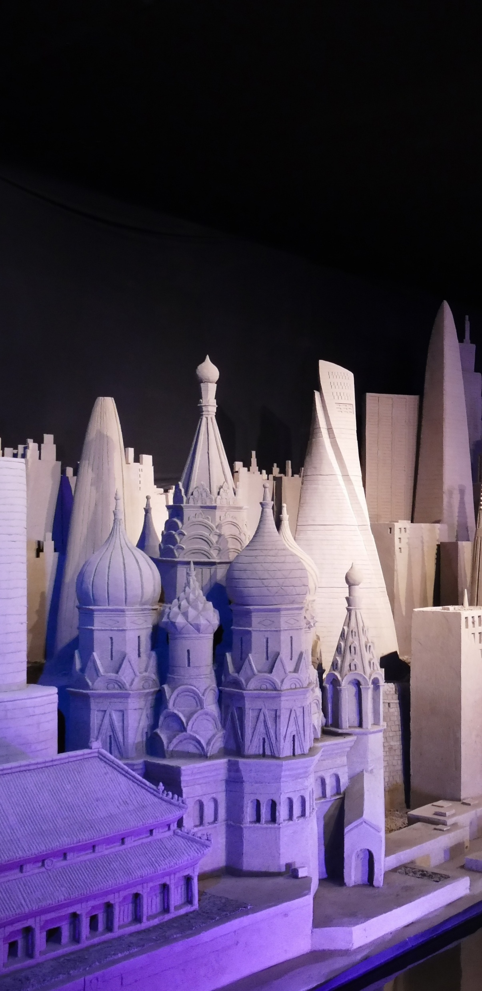
- EZRA -
A RETURNING REMNANT
God can Restore after Failure: “He made it again”
When life, whether individual or national, is broken God can re-make it
God is sovereign
Carelessness, cowardice and contempt replaced with conviction, courage and confidence

Slide 17
- NEHEMIAH -
CONSOLIDATION
Any Restoration must be spiritual
Return to God’s Laws and live by faith
Confidence in God
Action in accord with his will
No compromise with what is wrong

Slide 18
- ESTHER -
GOD AMID THE SHADOWS
God …
Maybe hidden but always active
Apparent trivialities are not outside his concern
Righteousness and power
The Application …
Reckoning with God will lead to confidence and courage
Rebellion against God will end in panic and punishment

Slide 19
- JOB -
THE PROBLEM OF PAIN
Humanity’s need in loss
True understanding of self
Light on the after-life
A connection to God
Trust in the government of God over good and evil
God’s Answer
A revelation of Himself in power and authority
To encourage humility and repentance
A mediator and redeemer will come who will show the truth about God, man, life, resurrection and suffering

Slide 20
- PSALMS -
THE BOOK OF WORSHIP
The God to be worshipped
Jehovah: The Infinite God becoming everything that man needs
Elohim: The Infinite God in Power and Might
Adonahy: The Infinite God as Sovereign Lord
His loving kindness endures forever
Man, the worshipper
Attitude: submission, trust, obedience, joy
Activity: openness and honesty, praise, devotion, making all circumstances opportunities for worship and praise

Slide 21
- PROVERBS -
PRACTICAL WISDOM
The Law of Wisdom
Wisdom is of God, he is all-wise
Man becomes wise only as he comes to know God and fear God
Fear of God is not terror, but apprehension of God as he has revealed himself leading to submission, obedience and love
Success in life in matters of family, friends, and everything else is determined not by fate, circumstances or fortune but by living God’s way

Slide 22
- ECCLESIASTES -
THE VANITY OF MATERIALISM
The Revelation of Folly
Foolishness is to de-throne God, to live without God
A life unyielded to God is “vanity”: a life of distorted truth; fatalism; seeking; selfishness; pessimism
A life yielded to God is to find the “Key of Life”

Slide 23
- SONG OF SONGS -
THE CANTICLES OF LOVE
Love is Supreme
Human life finds its highest fulfilment in the love of man and woman
Love is exclusive, contented, strong, unbreakable, an unquenchable flame
Complementary: Male - intense, protective; Female - answering, trusting
Human love is a representation of true spiritual religion: passion, abandonment, fidelity

Slide 24
- ISAIAH -
THE PROPHET OF THE THEOCRACY
God’s Throne - Man’s part: Submission
Submission to the government of God in his holiness and righteousness is the one sufficient condition for the true fulfilment of all human life, personal, social, national
God’s Throne - God’s part: Grace
Restoration of human life from its sin bruised and broken condition is only made possible by the grace of God.
Grace is the inspiration of salvation

Slide 25
- JEREMIAH -
THE PROPHET OF FAILURE
God’s Law: Sin is certain Destruction
The reason for national ruin and personal failure in life is sin
The root of sin is the forgetfulness of, and rebellion against God
The Heart of God is wounded by Sin
God is grieved by sin and its end, which is judgment
The Victory over sin is with God
He will save and his Saviour is appointed

Slide 26
- LAMENTATIONS -
LAMENTATIONS OF JEREMIAH
The 5 laments of Jeremiah
The desolate city of Zion - because she has grievously sinned
Desolate because God has come in judgment - an appeal for penitence
God has been just but will yet come in mercy if the people turn back
The desolation and sins laid out. The vanity of help from men
An appeal to God to remember their affliction and turn them again unto Him

Slide 27
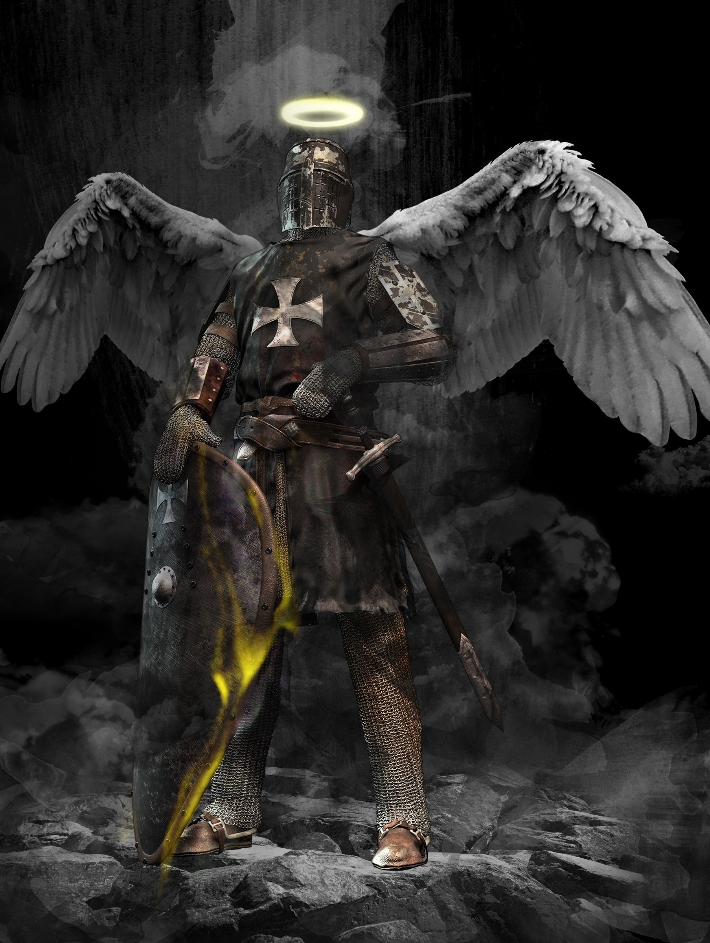
- EZEKIEL -
THE PROPHET OF HOPE
A Vision and Knowledge of God
Supremacy: He will Judge against Sin
Serving: He is the Shepherd, restoring
Manifestation: His purpose “that they may know Jehovah”
Mystery: A new order and last temple “The Lord is there”
Such a Knowledge of God is the reason for Hope
Such a knowledge of God is the inspiration for joy and hope

Slide 28
- DANIEL -
THE PROPHET OF INTERPRETATION
Another vision of God’s Government
In command of human kings and world events
Bringing down and raising up
Against evil and preserving good
Caring for those who honour him
In command of the future
God’s wisdom and might and mystery in determining future events
An end to sins and everlasting righteousness are in sight

Slide 29
- HOSEA -
SPIRITUAL ADULTERY
A message for God’s People
Compromise with the world is spiritual adultery, a most serious sin against the love of God
God’s judgment is inevitable: God’s people can speak no authoritative witness to the world
God will heal the sin of compromise and restore God’s people but only when they turn to him: His love is not gone
God’s people must have “nothing more to do with idols”

Slide 30
- JOEL -
THE DAY OF THE LORD
The “Day of the Lord”
A day of judgment against sin and a day of victory for grace
The day of the Lord is always present and always coming
God is patient, waiting for repentance, graciously intervening to warn of the coming judgment which will finally come

Slide 31
- AMOS -
NATIONAL ACCOUNTABILITY
To the Nations
Nations indulging in corruption, immorality and violence - rejecting God’s righteous laws do not escape God’s attention and he is watching and waiting
God is ready to act to bring down evil and renew for good
To God’s People
God’s people who have the truth and light must be righteous having no part in national sins; if not they will come under more severe judgment
Righteousness will be victorious

Slide 32
- OBADIAH -
THE CURSE OF COWARDICE
Defiance against God and his people
Those who de-throne God and deify themselves, God, most certainly, will bring down
Defiance against God, reliance on self can only lead to ultimate destruction – God cannot be mocked
God’s people may suffer but the Kingdom belongs to God and all opposing Kingdoms will one day fall
Even so there is hope for those who defy God through repentance

Slide 33
- JONAH -
CONDEMNATION OF EXCLUSIVENESS
God’s concern for those not yet his own
God wants all to know him and works to warn that sin will certainly lead to judgement
God needs his people to bring his message to those who have not heard
God’s people fail when they refuse to share God’s message because they have little concern or love for those who do not show any respect for God

Slide 34
- MICAH -
AUTHORITY FALSE AND TRUE
Warning against corrupted Authority
Authority is always delegated by God but may be corrupted
False motives of political, spiritual and moral teachers: selfish, greed, seeking bribes and status
People are not served with justice
The true Ruler who is good
“Coming out of Bethlehem”
A true and good Ruler is coming who will bring peace and hope

Slide 35
- NAHUM -
VINDICATION OF VENGENCE
The Anger of God and his Action
God is passionate for holiness and will exercise vengeance on his adversaries
God is slow to anger and a safe stronghold for all who put their trust in him but will make an end of his all enemies
The law is to love God and neighbour: disobedience is to rob love and God must act in judgment
To believe in the love of God is to be sure of his anger against hate

Slide 36
- HABAKKUK -
THE PROBLEMS OF FAITH
The Problem of Faith
Faith is often bewildered by circumstances
There is suffering, violence and cruelty and God does nothing
The Triumph of Faithfulness
“My righteous one shall live by faithfulness”
Do not judge by appearances: God is presiding over everything.
Events will work to their conclusion and will most definitely confirm “God’s righteous one shall live” because of perfect faithfulness. Wait on the Lord

Slide 37
- ZEPHANIAH -
THE SEVERITY AND GOODNESS OF GOD
The “Day of the Lord”
God’s intervention: Man’s judgment and God’s Kingdom are coming
God will utterly destroy all sin and its influence on everything
Judgement will be discriminative, holiness and righteousness will be vindicated
So that God can be enthroned
So the righteous can rejoice in the hope of the glory of God

Slide 38
- HAGGAI -
THE DUTY OF COURAGE
To God’s people in times of difficulty
“Be strong … and carry on!”
There is a danger of being content with a time of weak advance of the Kingdom
There is a danger of being discontent because other times were better
There is a danger of false expectation of better and faster progress
There is a danger of being afraid because of the success of the enemy
All these issues are to be left with God
We are called only to do our part “Be strong … and work”

Slide 39
- ZECHARIAH -
THE APOCALYPSE OF THE OLD TESTAMENT
To God’s people the secret of strength
God’s power is pervasive, his purpose is persistent
God is the sovereign Lord and Master of his Universe
Return to me and I will return to you
The secret of strength is to recognise the unseen things which are eternal
Though the “Branch” was rejected he shall be crowned
“Not by might, nor by power but my Spirit” shall all things be brought to pass

Slide 40
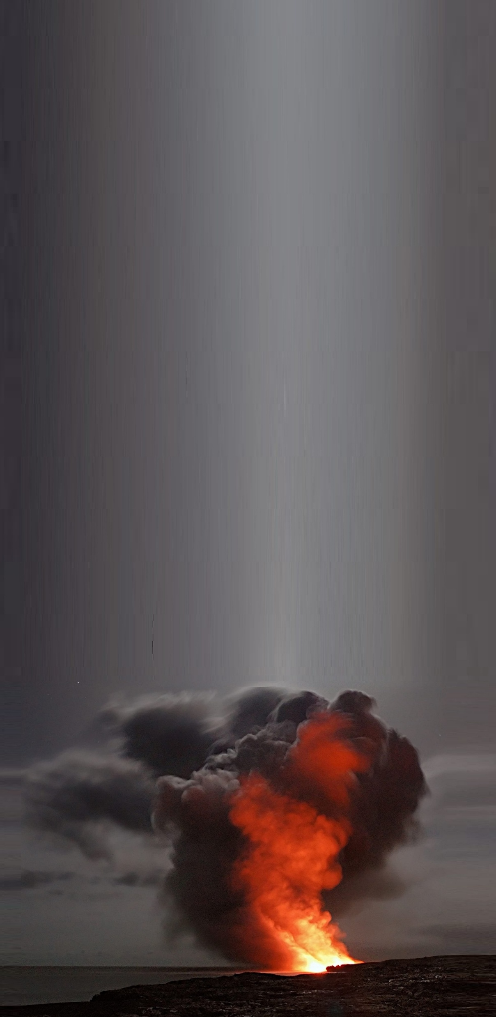
- MALACHI -
UNCONSCIOUS CORRUPTION
God’s charge against his people
I have loved you. But you are indifferent, you have called evil good, you have robbed me and said there is no worth to serving me.
Your religion has become a formal duty
You have lost your love for me and you are unaware of your sin. You say “How have I loved you?”
The correction
“Think upon my Name”. Count up the wealth you have in that Name. It is a strong tower.
Set your hope on the One who has come. His light will heal the repentant but burn his enemies

Slide 41
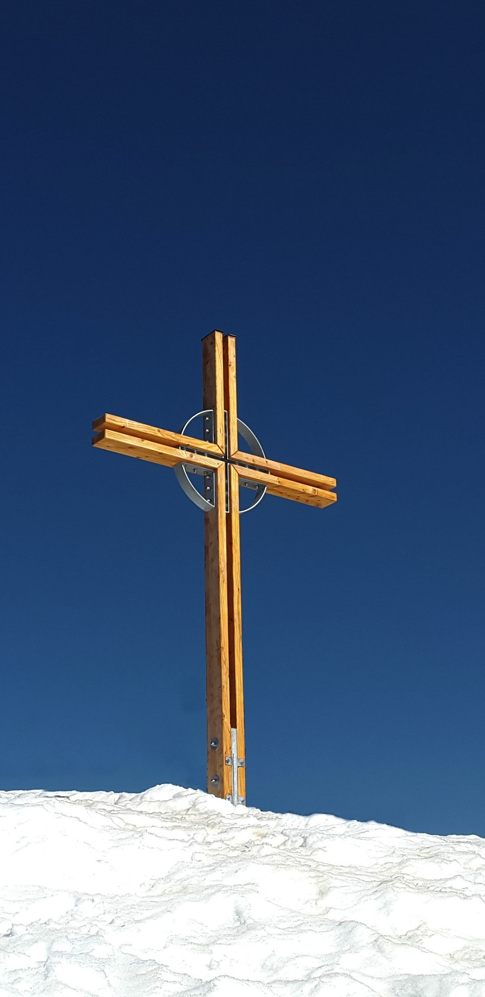
- MATTHEW -
JESUS CHRIST THE KING
Repent: the Kingdom of Heaven is at Hand
In other words: “Rethink the way you live because the King is here in person and will be establishing His rule”
“His rule” will be according to righteousness, a righteousness that is not merely outward, but a life of righteousness like the character of God
“Rethinking” means (i) considering our way of life; (ii) realizing it falls short of God’s standard and (iii) asking God to change us, giving over our lives to him and receiving his life and submitting to him
“His kingdom” is the realm of peace and joy; not worry, unrest and disaster

Slide 42
- MARK -
JESUS CHRIST THE SERVANT
Jesus Christ becomes God’s Servant, by giving his life, to bring Good News to men
Though equal with God, Jesus humbled himself and became the servant to give his life as a ransom
Jesus did this to provide salvation for people
Jesus took to himself the burden of others, human sorrow and suffering and sin
He gave himself to be the saviour of others
In doing so he made salvation possible and showed the way of life for his followers: submission and trust in God; compassion; service to others; sacrificing our desires for what God wants and to make known his Good News to all people

Slide 43
- LUKE -
JESUS CHRIST THE MAN
Jesus Christ: the second Adam and the first-born of a new race
Equal with God and God’s son, Jesus was also the son of Mary conceived miraculously and without sin
He lived a perfect and pure life, radically distinct from other men and no man could find fault in him
He became the first-born of a new race; the Son of Man, the second Adam
He came to seek the lost, offering his life as a new possibility for people
By the mystery of his death he ended sin and made it possible for us to be partakers of his divine life by giving up our old life

Slide 44
- JOHN -
JESUS CHRIST THE WORD OF GOD
Jesus Christ: the Word of God
The King of Matthew; the Servant of Mark, the Man of Luke is now unveiled in John as from everlasting; the Word in flesh, declaring the unseen Father; full of grace and truth
Grace: Love was God’s inspiration in sending Jesus; everything Jesus did illustrated his message of love - the miracles bringing healing and life
Truth: Jesus brought light to man, revealing God; everything Jesus said illustrated the divinity of God - I am … bread … light …way … shepherd … life etc.
Therefore give to Jesus what we owe: our worship as and dedicated loyal service - he is our loving Lord God, and our Saviour

Slide 45
- ACTS -
THE CHURCH FORMED AND WITNESSING
“Better for them that he should go away”
Jesus now ascended, the Spirit sent and the Church formed
A new beginning: a community to be established
A new principle: living and working under the guidance and direction of the Spirit
A new unity: all who believe in the risen Lord Jesus are united equally into one new fellowship by the Spirit
The work of the church: glorify God by living in likeness to Jesus and revealing him to the world

Slide 46
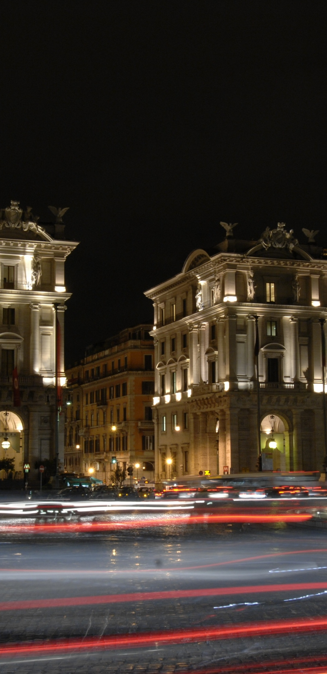
- ROMANS -
CHRIST THE SALVATION OF GOD
The helplessness and ruin of man and the perfection redemption of God’s salvation
Man’s sin, his rebellion against the authority of God is the reason that the whole creation is in pain
Man has no power to restore himself to God or escape God’s judgment against sin
Jew and Gentile have fallen short of the Glory of God
The righteousness of Jesus, Son of God, has been made freely available to every person by faith
Jesus’ death has the power to justify, sanctify and glorify the sinner who believes
If we refuse the love and mercy offered by the grace of God then we must endure God’s penalty for sin

Slide 47
- 1 CORINTHIANS -
CHRIST AND HIS CHURCH,
THE MEDIUM OF WORK
Weakened witness due to evil influences
Every church has a responsibility to declare the gospel to its city and local people
The gospel witness can only be effective when lives show God’s love, righteousness and truth
All the Christ’s resources are available but the church must make all her resources available to Christ
The church at Corinth had been invaded by the influence of the city - evil and disputes had come in
The church’s witness was weak and she had failed in her responsibility to the city
The church must be distinct from the city, living the life of Jesus, obeying the Spirit, glorifying God

Slide 48
- 2 CORINTHIANS -
CHRIST AND HIS CHURCH,
THE MEDIUM OF WORK
Vital truths about the church’s ministry
God’s sacred truth is the treasure of the church to be preached and taught on God’s authority, and that of his Word and his risen Christ
This message must be faithfully declared and not distorted or corrupted
This message can only be delivered through God’s blessing, the Spirit’s revelations, conformity to the will of God and prayer
The church’s ministry will not be achieved without tribulation, distress and suffering but there will also be joy, success, hope and satisfaction
Having received the grace of God, let our lives show that we have been reconciled with God

Slide 49
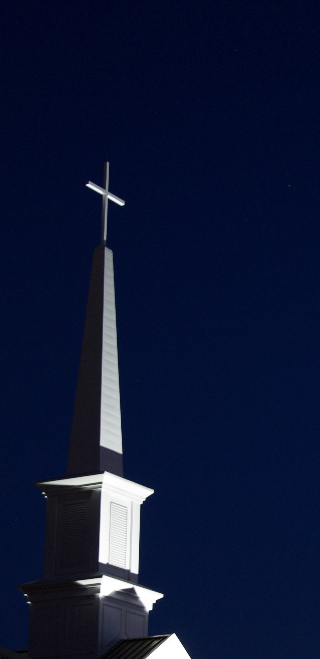
- GALATIANS -
CHRIST THE EMANCIPATOR
Faith in Christ and life by the Spirit
To add any rite or ceremony or observance as necessary to salvation is to sever from Christ
To believe and have faith in Christ and live under his Spirit is everything needed for salvation
Life is supplied by the Spirit, and governed by the law of the Spirit and love is the fruit of the Spirit
Christians are free from rites and ceremonies but subject to the Spirit; able to overcome sin and obey Christ by the Spirit alone
The only thing in life that matters is faith in Jesus and his death, which results in love: any other gospel is to deny Christ and lose salvation

Slide 50
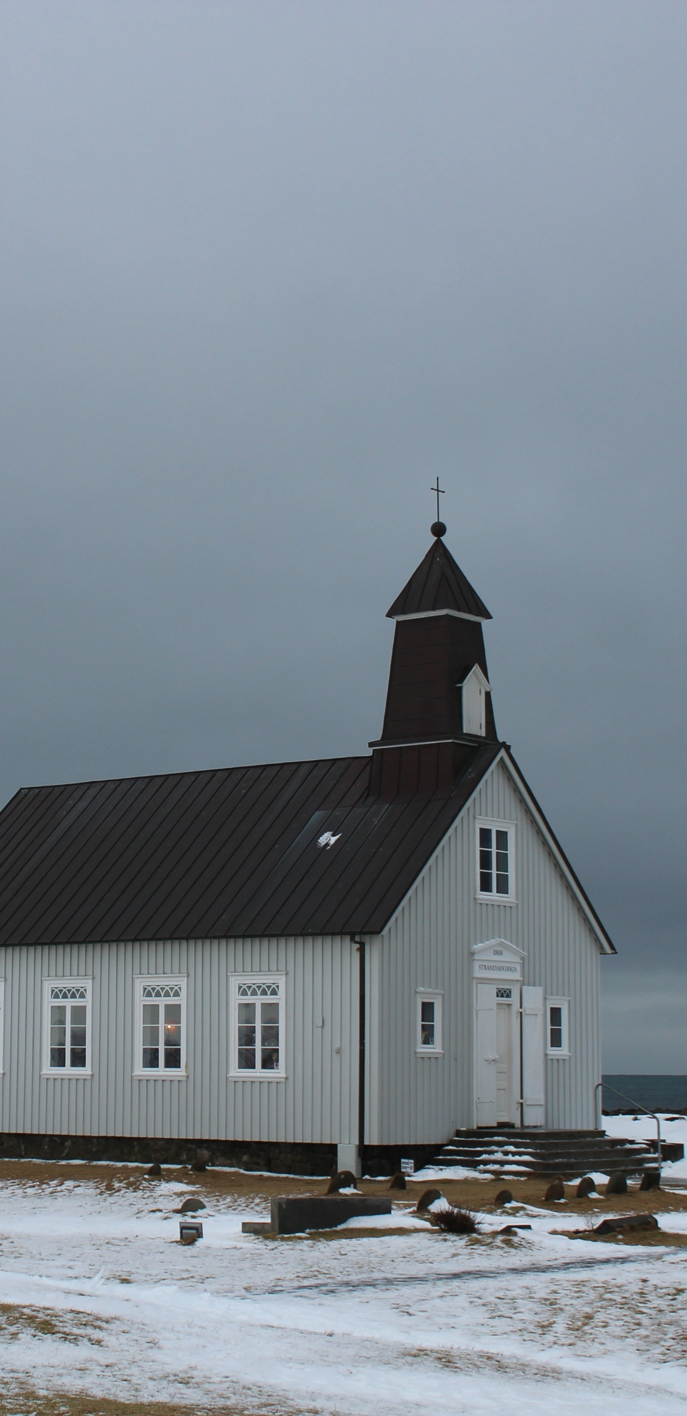
- EPHESIANS -
CHRIST AND HIS CHURCH,
THE ETERNAL VOCATION
The church: God’s eternal plan in Christ
The church was God’s plan from eternity and that it’s people should bear the likeness of Jesus Christ
Therein follows its sacred responsibility to walk worthily of such a calling
By unity; by sanctified lives; by “growing into Christ”: by showing the “key of life” through faith in Jesus
To fulfil this high calling the church’s members must live in likeness to Christ, its Head, in holy and pure lives, having on the armour of God
Such a calling means spiritual enemies, but God is able to keep … and by walking worthily is his Kingdom advanced

Slide 51
- PHILIPPIANS -
CHRIST THE SECTRET OF JOY
Be of the same mind as Christ
The mind of Christ? He emptied himself, he humbled himself, was obedient even unto death
Why? Out of perfect love to save men and women
Such a mind is to be that of his followers
His followers are to be willing to suffer anything to live for and witness to the life of Jesus
Christ was crowned with authority; his followers will be crowned with victory over life and realization of God’s purposes for each individual
Can this be done? Not by imitation or effort. It can only be done by “losing our life and receiving Christ’s” - with joy, without worry, by prayer, working out his will for us

Slide 52
- COLOSSIANS -
CHRIST AND HIS CHURCH,
MUTUAL FULNESS
The Christ: the church’s glorious treasure
The fullness of the Divine Godhead is in Christ
Christ’s followers are being made full by Christ
Christ, the creator and sustainer of all things, has become the First-born from the dead, won victory over the tragedy of sin and made possible peace and reconciliation through the blood of the cross
Because of Christ, man is being restored to the fullness of God’s original design for humanity
Most importantly, the relationship to God that man was created to enjoy can be and will be restored
Hold fast to these things and let nothing rob you or spoil this treasure

Slide 53
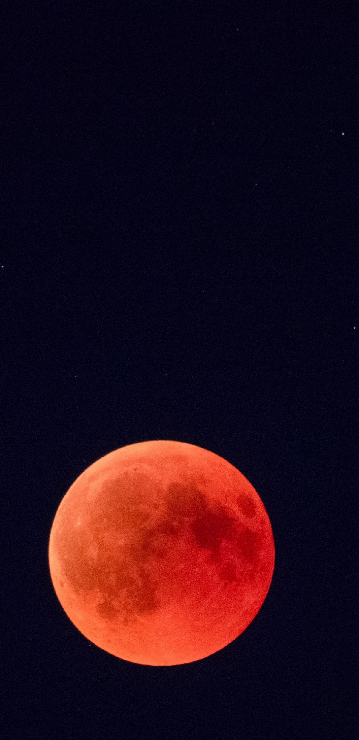
- 1 THESSALONIANS -
CHRIST AND HIS ADVENT
The Importance and Comfort of the Second Advent
As surely as Jesus had suffered on earth he would return as its sovereign King
Christ’s return to victory is the Christian’s reason for faith, unshakeable confidence, patient waiting, and inspiration for love and service
Faith is a venture that trusts in the first coming and waits for the second when it will be vindicated
The measure to which the second advent becomes vital and real to the Christian is the impetus to sanctification, Christlikeness, love for the others and certainty of coming judgement for sin

Slide 54
- 2 THESSALONIANS -
CHRIST AND HIS ADVENT
The Correct Understanding of the Second Advent
Christ’s return is not a reason for Christians to be troubled, shaken or giving up on daily life
The work of the Church and its gospel, as well as the outworking and manifestation of sin and evil, must all run their full course before Christ returns
The church must continue to be salt and light in the world, restraining evil, through the indwelling Spirit
A day will come when the church is taken away and evil will increase and Jesus will come in judgment
Until that time continue in the service of the Lord, living in his likeness

Slide 55
- 1 TIMOTHY -
CHRIST AND HIS MINISTER
The Church and its Minister
The function of the Church is to proclaim God’s Truth in the world through Godly lives and worship; the function of the minister is to explain God’s Truth in the Church through sound teaching and example
The Truth encompasses Jesus..:
manifest in the flesh
declared righteous by resurrection
seen alive by the apostles
taken up in glory
proclaimed to the nations
believed on by the church

Slide 56
- 2 TIMOTHY -
CHRIST AND HIS MINISTER
Responsibilities of the Church’s Minister
Many dangers and sins can cause the Church to fail in its testimony of Truth to the world
The minister must correct any weaknesses
The minister must have the Spirit’s gift for such a task and remain in close fellowship with God
The minister’s work is…:
instruction and character building
to know the scriptures
to teach and preach the scriptures faithfully
to test all things by the scriptures
correction of that which is not Christlike
to walk with God through prayer and study
to do all things with the grace of God

Slide 57
- TITUS -
CHRIST AND HIS MINISTER
The Church: true to Jesus and his Truth
The Church is to live the doctrine of the Gospel by its individual members doing what is right and good
The power of the Church is in its measure of living out the Truth of Jesus Christ
That which works against the Truth must be corrected
The method of correction is for appointed overseers, themselves under the Truth, to speak, encourage and insist upon the Truth

Slide 58
- PHILEMON -
CHRIST AND SOCIAL RELATIONSHIPS
Faith and love triumph over circumstances
Fellowship with Christ gives the Christian triumph over circumstances because …
When the Christian abandons his own life, will and desires, and submits to Christ, then nothing can happen to him outside the good and perfect will of God.
Fellowship with Christ changes the Christian’s relationships with other people because …
“Love beareth all things” and “Love suffereth long and is kind”

Slide 59
- HEBREWS -
CHRIST THE FINAL SPEECH OF GOD
The Perfect Revelation is in the Son
In Jesus, God has given his most perfect, final and sufficient revelation of himself to man
Jesus has superseded everything before
Faith is the only principle by which man can draw near to God and partake in Jesus’ life and victory
Faith is …:
not merely intellectual belief, but
conviction in action
surrender and obedience in spite of circumstances
an energy that drives and accomplishes
triumphant even in suffering and waiting
Warnings of failure through disobedience
Encouragement to draw near, hold fast, press on

Slide 60
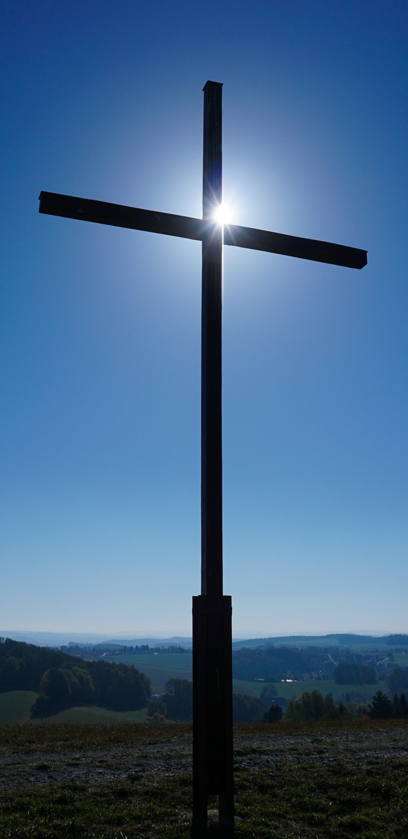
- JAMES -
CHRIST AND HIS ETHIC
“The Just shall live by his faith”
For faith to be faith it must result in a Godly life
In circumstances of trial, faith leads to patience
In temptation, faith leads to steadfastness
In matters of religion, faith is love for those in need, and separation from “worldliness”
In attitude, faith respects others
In speech, faith responds with heavenly wisdom
Negatively, life contrary to the will of God denies true faith: whenever we sin, our faith fails
Prove faith by venturing on it - the results will be the proof of faith, leading to patience and perfection

Slide 61
- 1 PETER -
CHRIST THE STRENGTH OF HIS PEOPLE
The Grace of God - “Stand fast in it”
In suffering, difficulty and testing all that is needed is the grace of God
Grace: love which according to foreknowledge of God chose a people for sanctification and obedience by the sprinkling of the blood of his son
Grace: foretold and sought for by the prophets, now supplied by Jesus, to be fully revealed at his return
Grace …:
freely available
the secret of confidence and conduct
the secret of character and courage
the secret of living in Emmanuels land (for both now and eternity)

Slide 62
- 2 PETER -
CHRIST THE STRENGTH OF HIS PEOPLE
The Grace of God - “Grow in it”
It is not enough to stand fast in God’s grace there must also be growth
Grace: Divine power so that Jesus followers would become like him
The responsibilities of Grace: (i) appropriation of the Divine power by faith and (ii) avoidance of perils
First, remember Christ’s death and diligently respond by holy living and godliness, anticipating Jesus’ return
Second, remain faithful to the truth; avoid false teaching
Growth is by God’s power but only through personal co-operation and diligence

Slide 63
- 1,2,3 JOHN -
CHRIST AND FELLOWSHIP WITH GOD
The Teaching and Illustration of Fellowship
The Christian’s life is a life of fellowship with God
The pattern for our life is Christ’s life - perfect selfless love and sinlessness
Only by receiving the regenerating life of Jesus can the pattern of love and light be known and realised
Fellowship with God means a life motivated by love and living in the light of God
Friendship with God means a life of realised potential and fulfilment of God’s purposes
Therefore respond when love calls
Therefore seek light and obey its calling
So test that our fellowship is genuine by love and light

Slide 64
- JUDE -
CHRIST THE PERFECT
AND PERFECTING LORD
Contend earnestly for the Faith
Beware of the influence of those within the Church that deny Jesus Christ through living in unbelief, licence, immorality, self-righteousness, greed, disloyalty to the teaching and grace of the Lord etc.
The disastrous end of such is certain
The Christian must be loyal to the Lord, passionate, courageous and careful, keeping in the will and love of God
God is able to keep his own from stumbling and at the end, set them before God with exceeding joy and without blemish

Slide 65
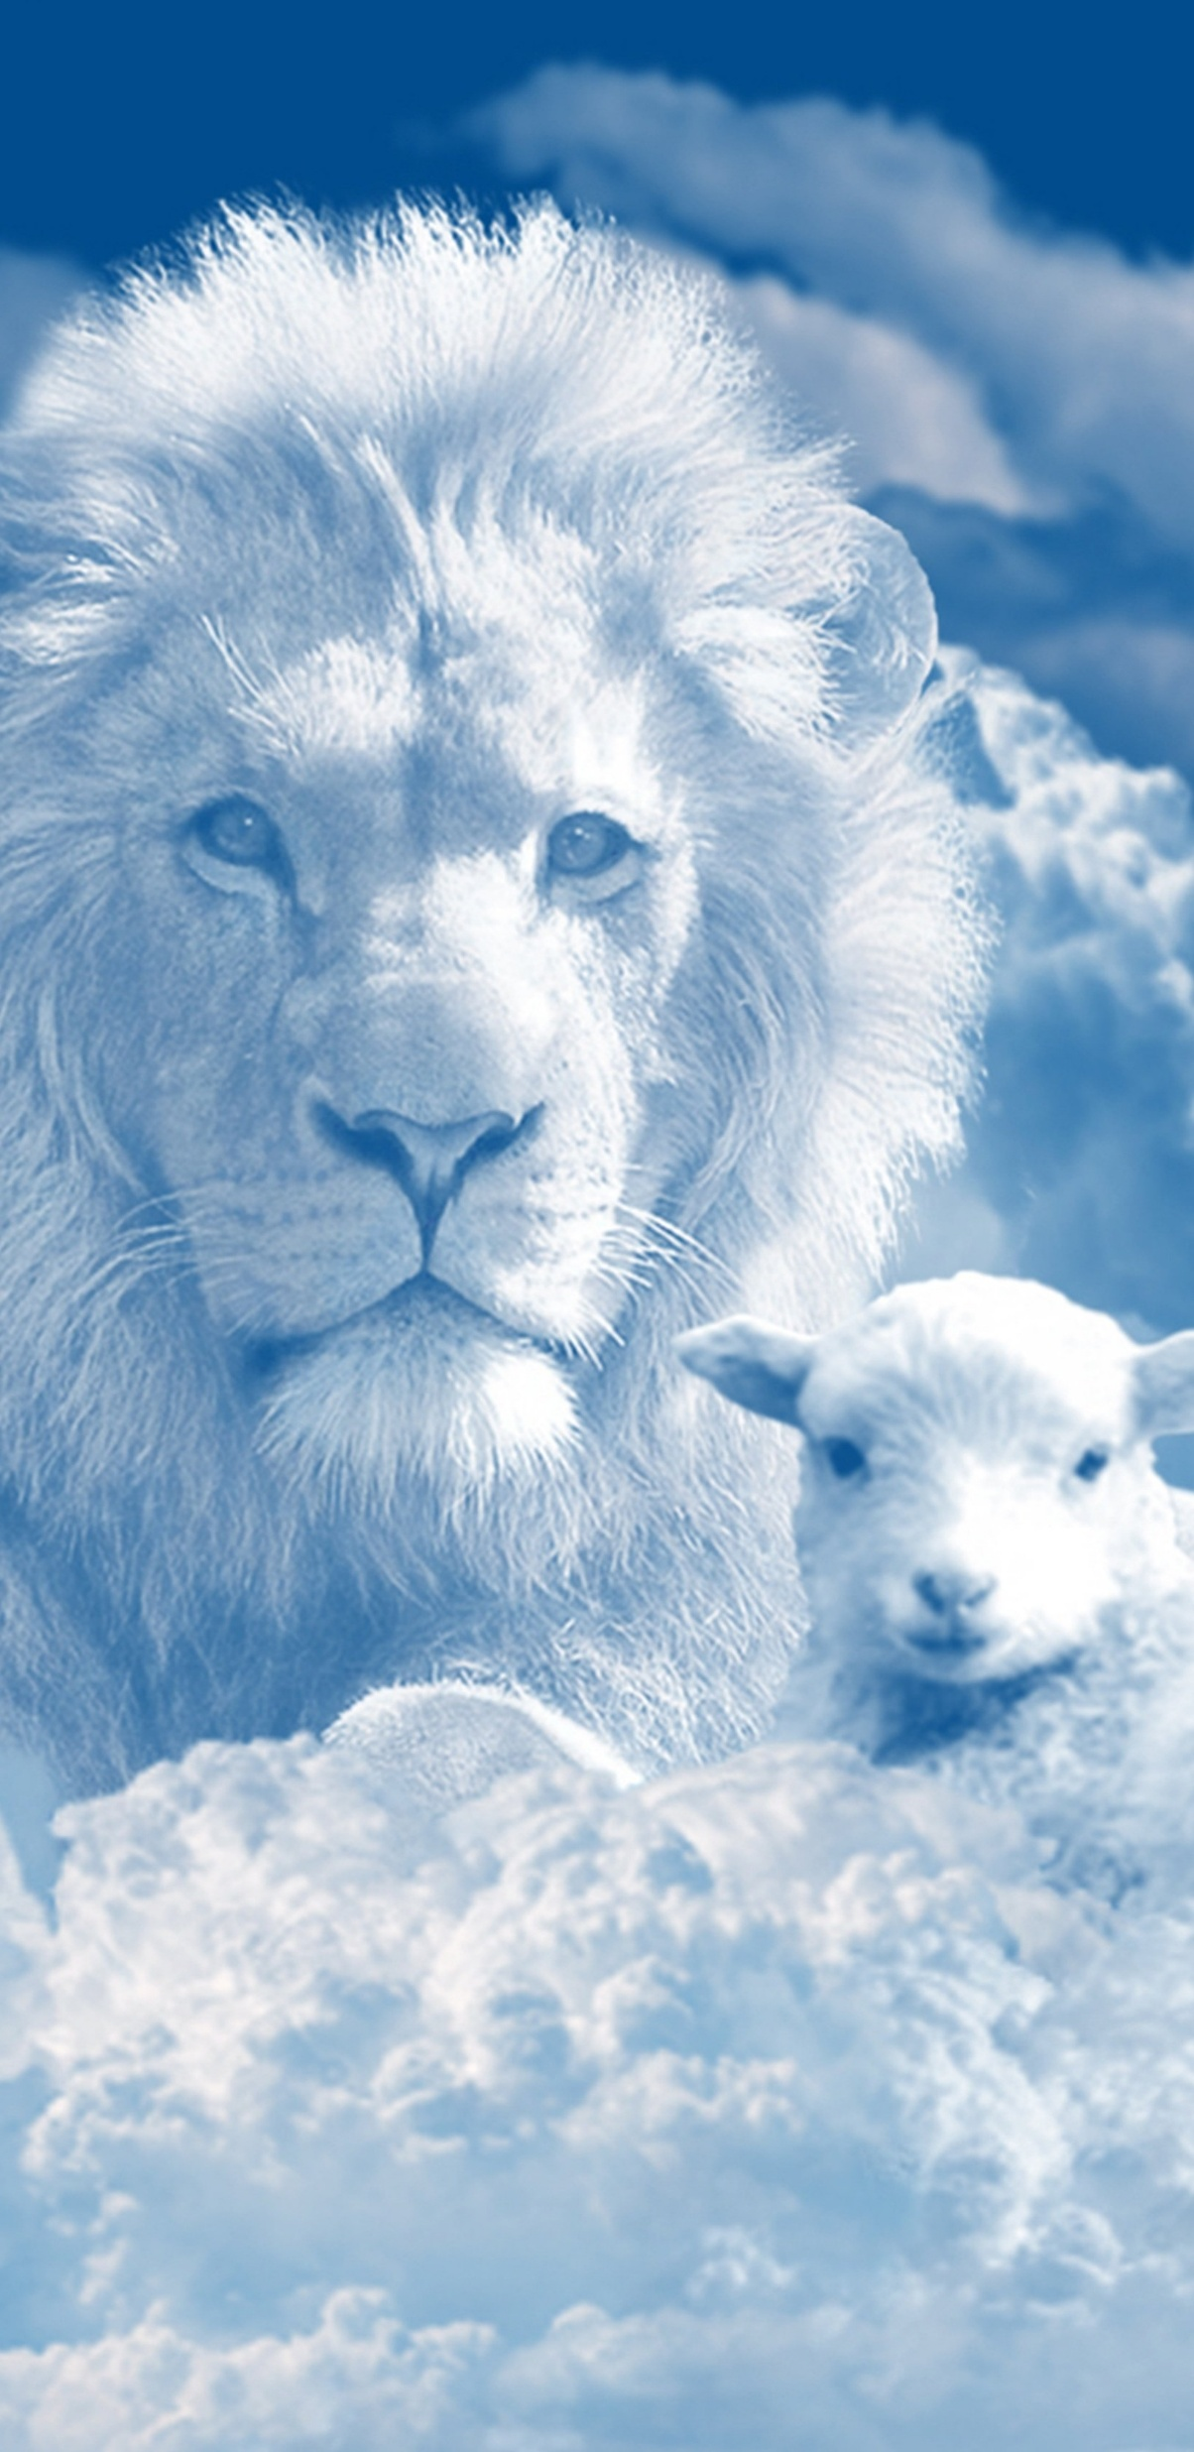
The Unveiling of Jesus Christ
Jesus: the Alpha and Omega, the first and the last: Jesus is the Almighty Sovereign God
His Vocation: he is the High Priest having offered his blood for sin; he is the King establishing his Kingdom; he is the Prophet revealing truth
His Power: to direct world events, authorities, spiritual forces and natural forces
His Method: He is at war with sin
His Purpose: that God will dwell with man in a new creation and be God will be glorified in man and in man’s redemption
- REVELATION -
THE UNVEILING OF JESUS CHRIST

